Slide 1

UNIVERSITY INSTITUTE OF ENGINEERING
COMPUTER SCIENCE ENGINEERING
Bachelor of Engineering (Computer Science & Engineering)
Subject Name: Internet of Things
Subject Code: 20CST-357
IoT Standard Issues
DISCOVER . LEARN . EMPOWER

Slide 2
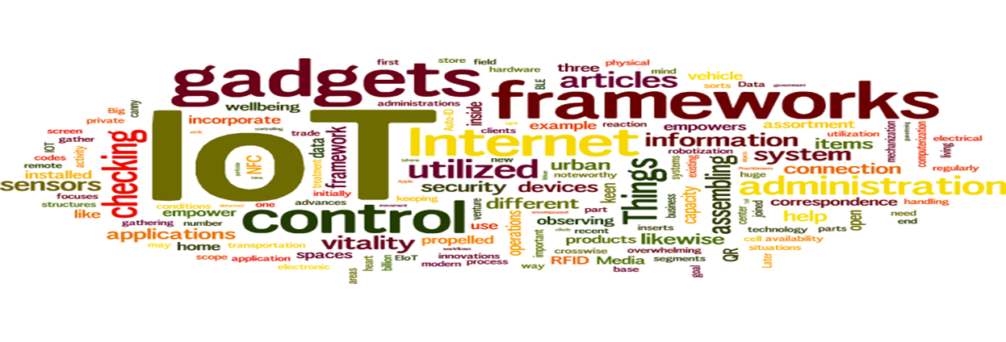
Internet of Things
Course Outcomes:
1. Analyze the basic terminologies associated with IoT and use it.
2. Justify the applications of internet of things and correlate them.
3. Compare different objects and communication strategies and also able to see the issues raised by communication strategies in IoT.
4. Examine the protocols required for communication and packet size required for each application.
5. Illustrate security issues with IoT like security, privacy, communication standard and some other legal issues.

Slide 3
UNIT 3 CHAPTER 5 IoT Standard Issues

Slide 4
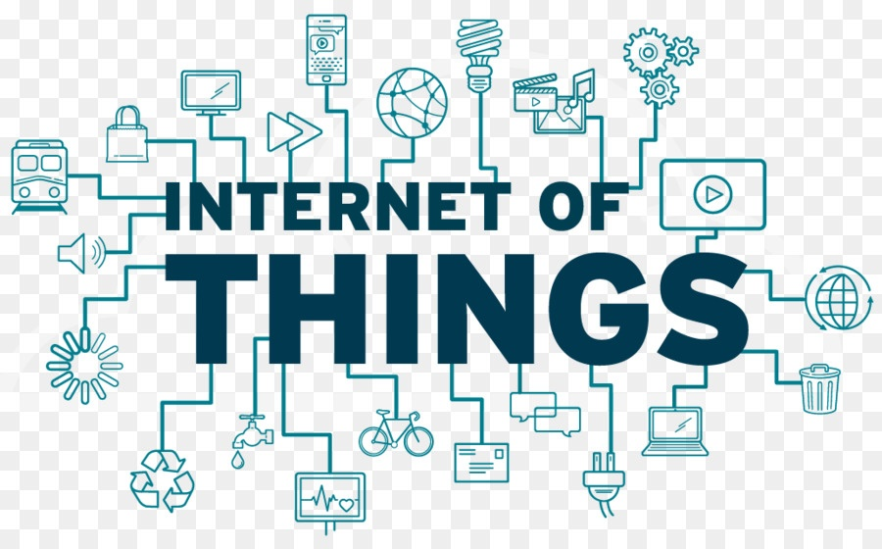
Internet of Things
IoT Interoperability / Standards Background
Key Considerations and Challenges in IoT Interoperability / Standards
Regulatory, Legal, and Rights Issues: Data Protection and Cross border Data Flows
IoT Data Discrimination
IoT Devices as Aids to Law Enforcement and Public Safety
IoT Device Liability

Slide 5
IoT Interoperability and Standards Background (CO-5)
IoT interoperability is the capacity for multiple components within an IoT deployment to effectively communicate, share data and perform together to achieve a shared outcome. Organizations must be able to transmit and understand data throughout all the connections from devices to the cloud.
"Interoperability in an IoT context refers to the ability to transport meaningful, actionable information between systems. Information can refer to many things, so it's important to understand that IoT is a vast system of systems, where connections and data exchange can occur between literally billions of devices and systems," said Shawn Chandler, CTO at GridCure and a senior member of the professional association IEEE.

Slide 6
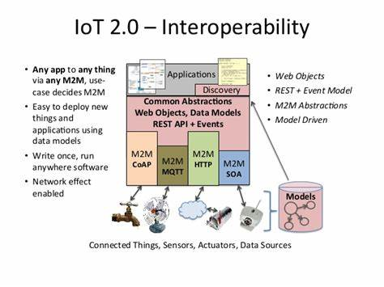

Slide 7
IoT deployments have three interoperability needs:
Technical interoperability. The deployment has the ability to use a physical communications infrastructure to transport bits of data.
2. Syntactic interoperability. A shared syntax or common information model structures the data and establishes a protocol to share the information as specific typed data.
3. Semantic IoT deployments require the ability to establish
the meaning of the data.

Slide 8
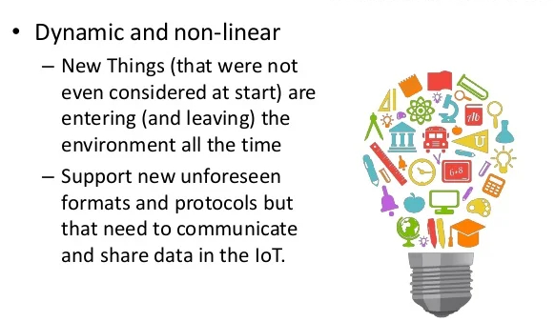
Interoperability Framework

Slide 9
Interoperability standards bridge IoT device communication
Many within the IoT community, including manufacturers and engineers who design connected ecosystems for use, work together to develop standards that address interoperability challenges. Multiple standards organizations have rallied around the cause, but there's no dominant common standard that's applicable in every IoT use case.

Slide 10
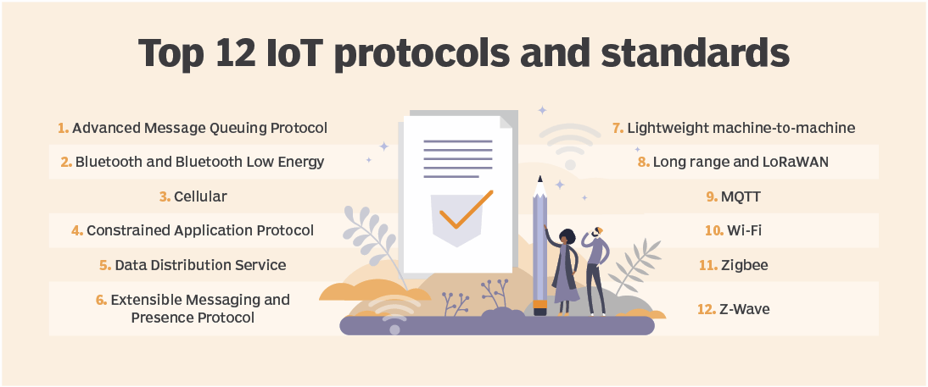

Slide 11
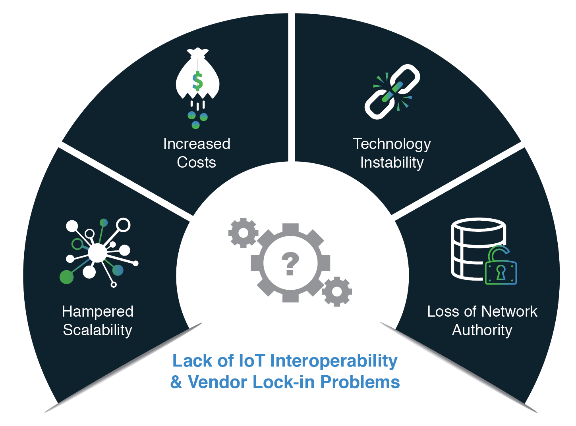

Slide 12
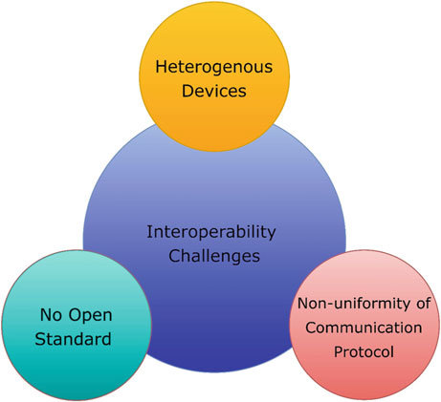

Slide 13
Key Considerations and Challenges in IoT Interoperability/Standards (CO-5)
The 10 most important considerations for IoT solutions:
1. IoT Security
2. IoT Analytics
3. IoT Device (Thing) Management
4. Low-Power, Short-Range IoT Networks
5. Low-Power, Wide-Area Networks
6. IoT Processors
7. IoT Operating Systems
8. Event Stream Processing
9. IoT Platforms
10. IoT Standards and Ecosystems

Slide 14
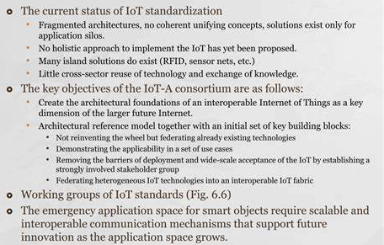
IoT Protocol Standardization Efforts

Slide 15
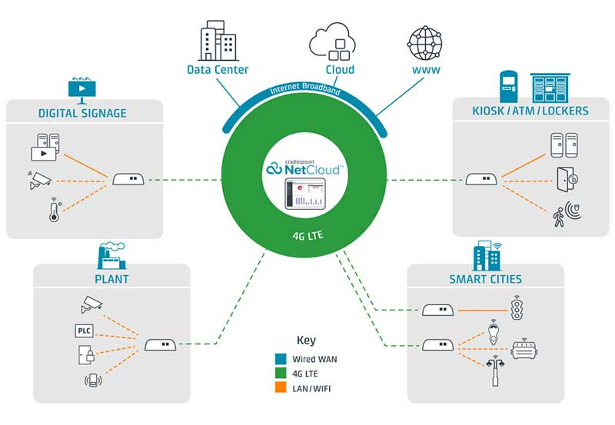

Slide 16
The hurdles facing IoT standardization can be divided into four categories; Platform, Connectivity, Business Model and Killer Applications:
Platform
2. Connectivity
3. Business Model
4. Killer Applications: In this category there are three functions needed to have killer applications: control "things", collect "data", and analyze "data". IoT needs killer applications to drive the business model using a unified platform.

Slide 17
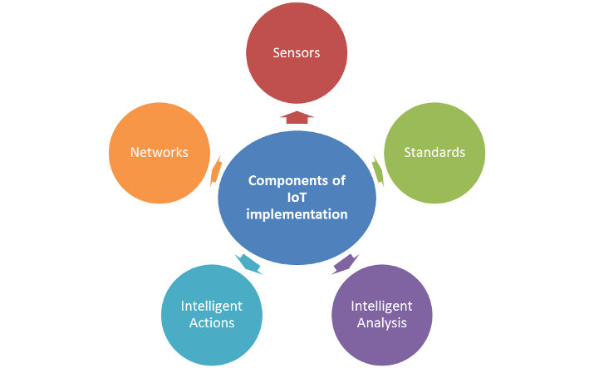

Slide 18
Issues with IoT Standardization
• Standardization is like a double-edged sword: critical to market development, but it may threaten innovation and inhibit change when standards are accepted by the market.
• The following two issues for the IoT standardization in particular and the ICT standardization in general may never have answers
• ICT standardization is a highly decentralized activity. How can the individual activities of the network of extremely heterogeneous standards-setting bodies be coordinated?
• It will become essential to allow all interested shake-holders to participate in the standardization process toward the IoT and to voice their respective requirements and concerns.

Slide 19
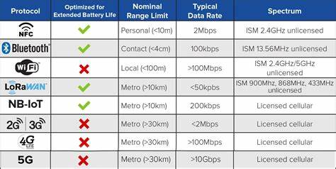

Slide 20
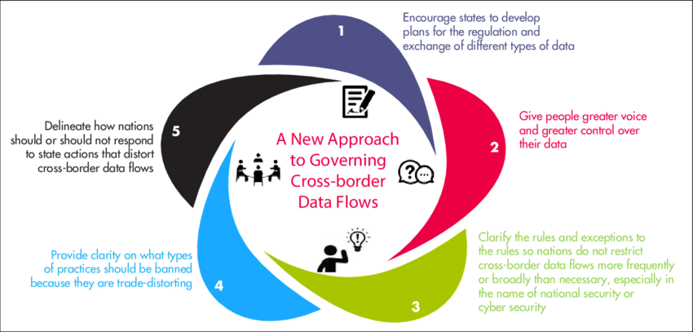
Regulatory, Legal and Right Issues: Data Protection and Cross Border Data Flows (CO-5)

Slide 21
Cross Border Data Flows
As the world moves online, facilitating cross-border data flows is essential. It has not only served as the foundation for modern economy but also continued to unlock innovative and promising societal benefits. Yet, over the past few years, regulatory friction around cross-border data flows has only deepened and governments around the world are grappling with competing policy priorities to protect data privacy, security, intellectual property and law enforcement access.
Recognizing the opportunities and challenges associated with cross-border data flows, the Digital Trade team engages the foremost political, business, cultural and other leaders of society to explore the ever changing impacts of data transfer mechanisms and shape domestic, regional and global arrangements on this novel governance issue.

Slide 22
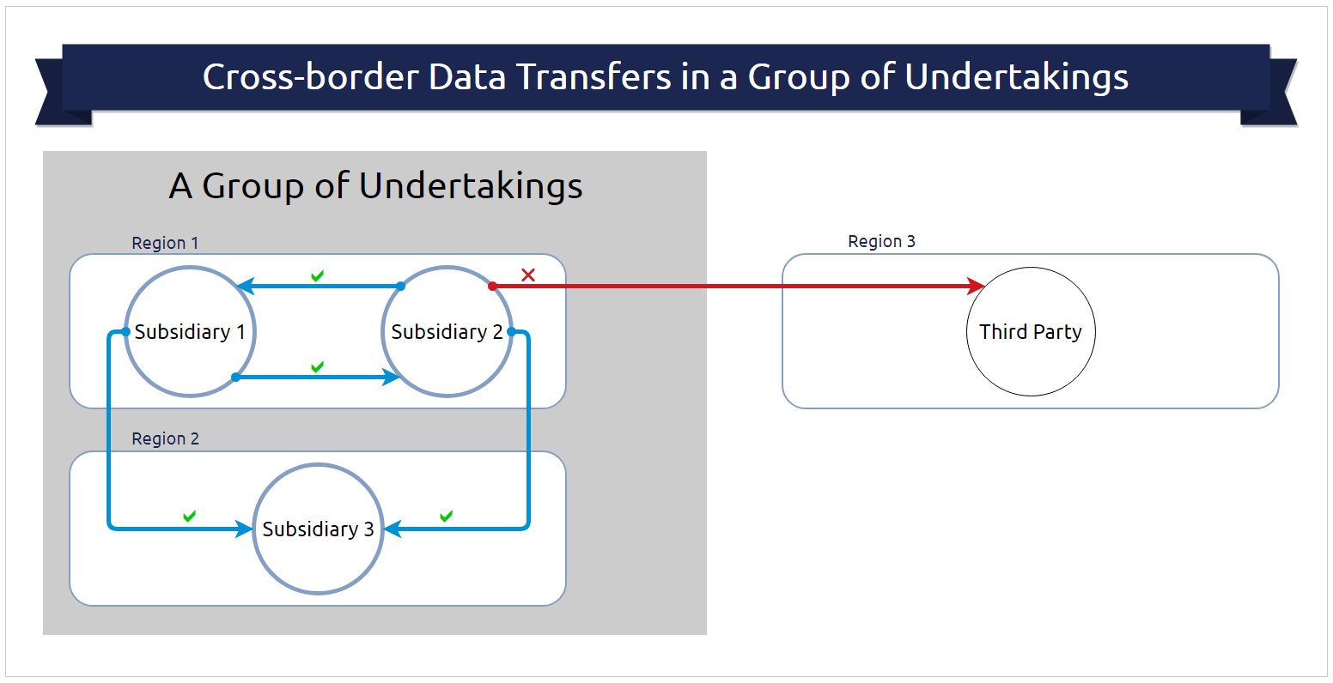

Slide 23
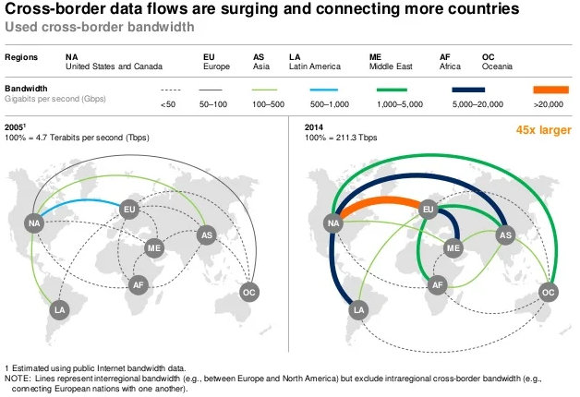

Slide 24
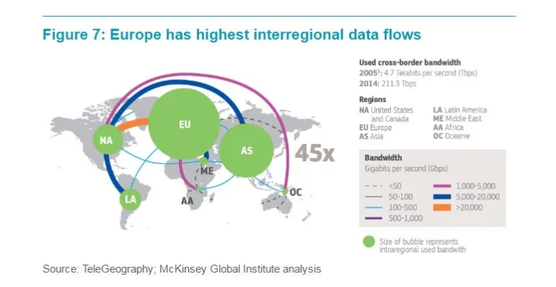

Slide 25
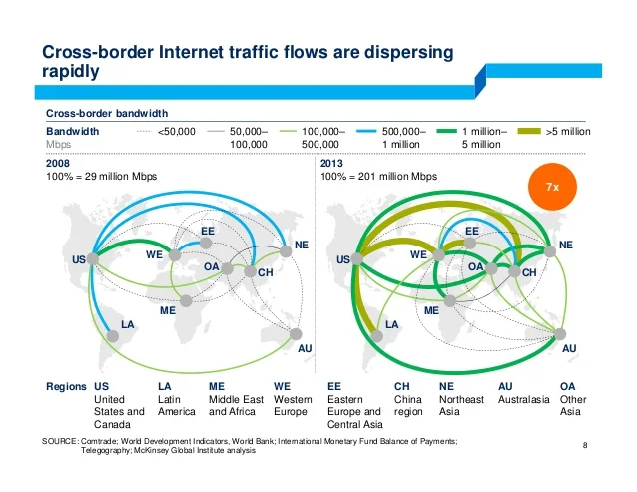

Slide 26
Cross-border data flows were first deliberated at international fora, before trickling down into domestic policy.
2. Countries’ conflicting value systems inhibit the development of a global treaty on data or Internet governance.
3. India consistently looks to preserve domestic policy space as it negotiates internationally on technology policy.
4. Market imperatives can help build global consensus between countries on cross-border data flows.
5. India’s upcoming G20 Presidency can bring differing points of view together and shape the future of digital governance.

Slide 27
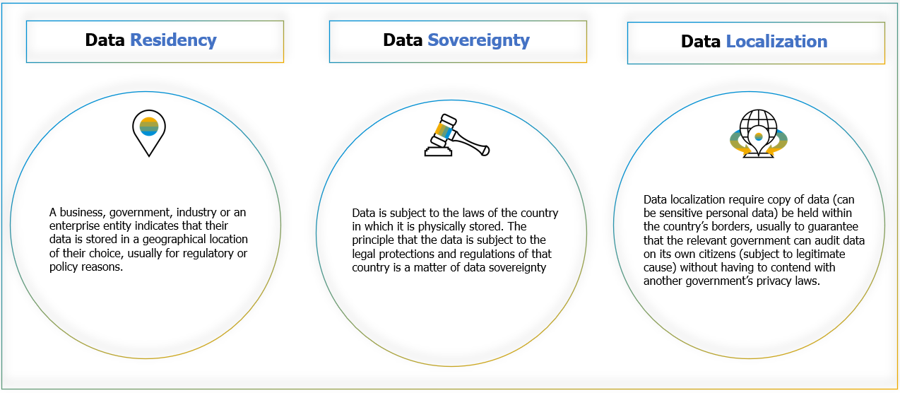
Challenges in Cross Boarder Knowledge Flows

Slide 28
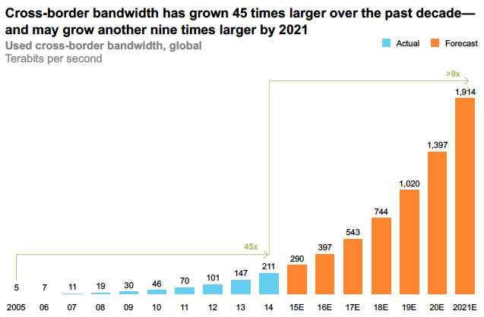

Slide 29
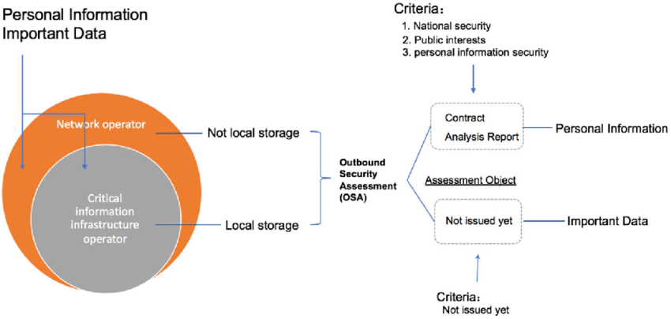
China`s Model for Cross Boarder Data Flows

Slide 30
IoT Data Discrimination (CO-5)
Data discrimination is a comparison of the general features of the target class data objects against the general features of objects from one or multiple contrasting classes. The target and contrasting classes can be specified by a user, and the corresponding data objects can be retrieved through database queries.

Slide 31
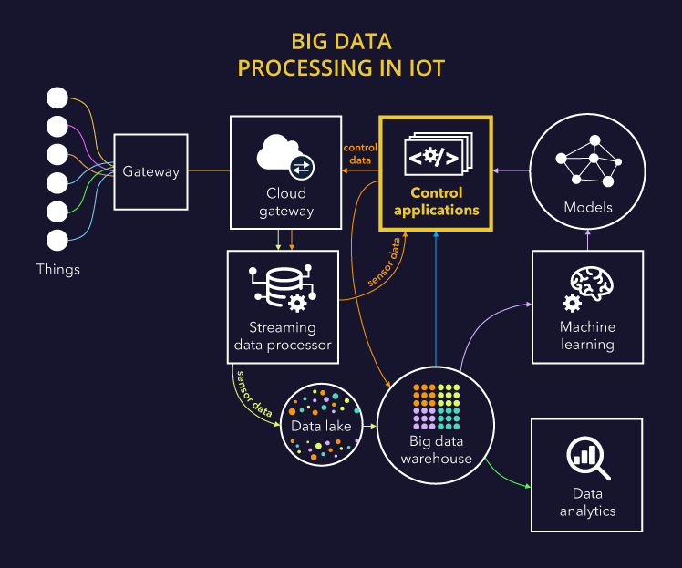

Slide 32
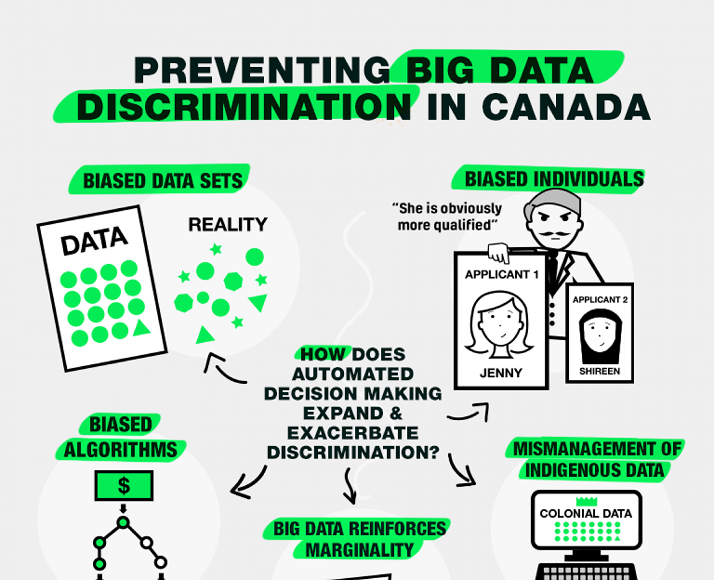

Slide 33
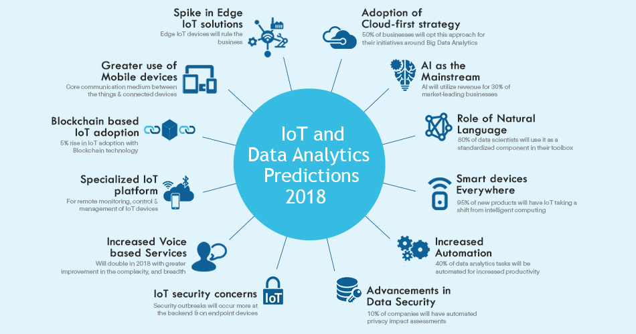

Slide 34
IoT Devices as Aids to Law Enforcement and Public Safety (CO-5)
Key areas where IoT is beginning to make a difference in law enforcement:
1. Crime detection
2. Evidence gathering
3. Wearable for law enforcement
4. IoT-enabled firearms

Slide 35
IoT and Law Enforcement
The contribution of the Internet of Things (IoT) is undoubtedly strong and uncountable in human lives. Be it pharmaceutical management or cybercrime. IoT is controlling each sphere of life. Law enforcement is also a working field of IoT. Regulation of law and enforcement of legal rights and laws is essential to improve human existence.
Laws not only secure the life of humans, but also protect the vulnerable from risks and damages. Laws play a critical role in ensuring the safety and security of a tribe and an area. Increasing criminal cases can be governed only by enforcing the right laws and policies.

Slide 36
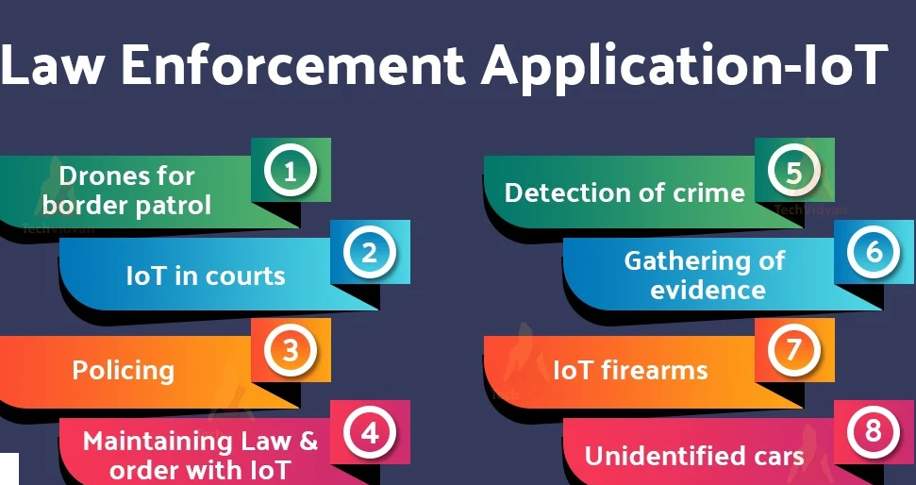

Slide 37
IoT Device Liability (CO-5)
The liabilities of IoT devices, software, or hardware affect the shareholders of the company, the developers, the distributors, and even the users. There is no doubt that the IoT technology is different from the rest of the technologies and hence identifying a breach becomes more difficult. When there is communication between devices via a network, the system is prone to DSoS attacks which are harder to track with IoT devices.

Slide 38
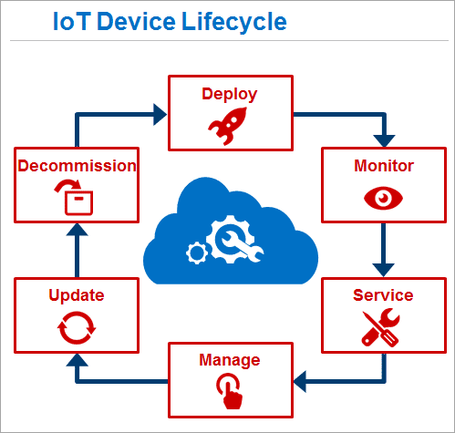

Slide 39
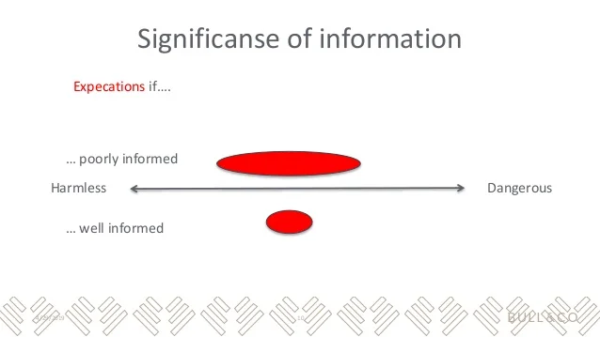

Slide 40
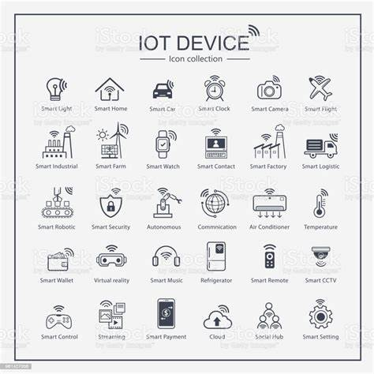

Slide 41
Major IoT liabilities :
1. Device Malfunction
2. Data theft
3. Cyber attacks
Given below are a few of the most effective methods to prevent cyber attacks:
a. Built-in security: Devices with inbuilt features for security are at lesser exposure to cyber attacks than those with less secure systems.
b. Encryption– manufacturers must ensure end-to-end encryption to allow safe communication between devices.
c. Risk analysis: There must be a proper system to calculate the risks of involving any functionality in iot devices and hardware.
d. Authorization: Hard to decode passwords prevent illegal access or login to private devices such as smart cars or smart homes.

Slide 42
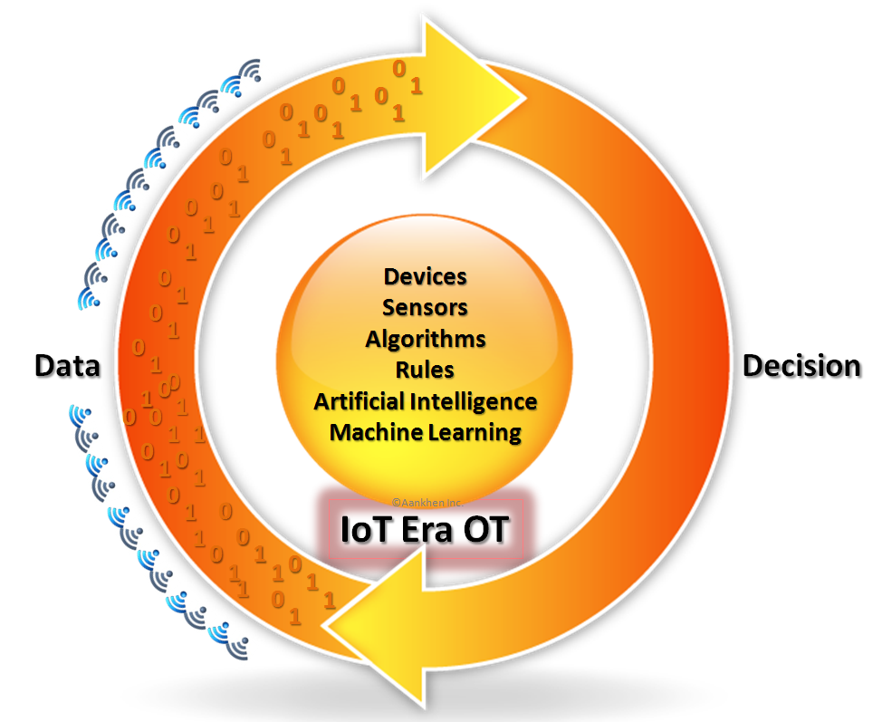

Slide 43
Impact of IoT liability
Any defective product impacts a chain of customers and organizations:
1. Product manufacturers
2. Producer of component parts
3. Product assembling party
4. Product installer
5. Wholesalers and vendors selling the product

Slide 44
IoT Product Liability Could Create Challenges for End-Users and Developers
As the market for internet of things devices grows, IoT liability is likely to become a critical issue for both end-users and developers. This could be especially true for end-users of industrial IoT products, who may face the potential for significant damages if an IoT device is compromised by hackers.
Experts expect significant uncertainty in the near future. Courts and lawmakers may adopt a range of positions on IoT liability. Developers could be held liable for damages often, or only in cases where end-users can prove that actions on the developer’s part led to the damages.

Slide 45
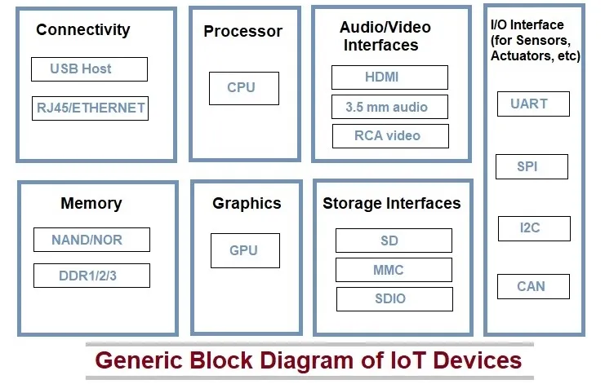

Slide 46
Summary
Regulatory standards for data markets are missing especially for data brokers; they are companies that sell data collected from various sources. Even though data appear to be the currency of the IoT, there is a lack of transparency about; who gets access to data and how those data are used to develop products or services and sold to advertisers and third parties. There is a need for clear guidelines on the retention, use, and security of the data including metadata (the data that describe other data).

Slide 47
Quiz
1. Interoperability is best defined as:
a. The exchange of the latest news information.
b. The ability of systems to work together in order to communicate and exchange information when necessary.
c. The development of the latest weather story.
d. All of the responses are correct.
2. Which Internet of Things (IoT) challenge involves the difficulty of developing and implementing protocols that allow devices to communicate in a standard fashion?
a. Security b. Privacy
c. Interoperability d. Compliance
3. Which one of the following is NOT an example of store-and-forward messaging?
Voicemail b. Unified messaging
c. Telephone call d .Email
4. Which action is the best step to protect Internet of Things (IoT) devices from becoming the entry point for security vulnerabilities into a network while still meeting business requirements?
a. Turning IoT devices off when not in use b.Removing IoT devices from the network
c. Using encryption for communications d.Applying security updates promptly.

Slide 48
5. What do organizations need to expect as they get more dependent upon the Internet of Things (IoT)?
Security risks will increase. b. Security risks will go down.
c. Security risks will stay the same. d. Security risks will be eliminated.
6. How many numbers of the element in the open IoT architecture?
a. Four elements b. Five elements
c. Six elements d. Seven elements
7. Which of the following is the way in which an IoT device is associated with data?
a. Internet b. Cloud
c. Automata d. Network
8. Which of the following IoT networks has a very short range?
a. Short Network b. LPWAN
c. SigFox d. Short range wireless network
9. An IoT network is a collection of ______ devices.
a. Signal b. Machine to Machine
c. Interconnected d. Network to Network
10. Which one of the following is not an IoT device?
a. Amazon echo voice controller b. Google Home
c. Nest Smoke Alarm d. None of these

Slide 49
REFERENCES
TEXT BOOKS
1. Ovidiu Vermesan, Peter Friess, “Internet of Things-Converging Technologies for Smart Environments & integrated Ecosystem”, River Publications Netherlands.
2. Internet Society, “An overview of Internet of Things”.
3. IoT Fundamentals: Networking Technologies, Protocols, and Use Cases for the Internet of Things by David Hanes, Gonzalo Salgueiro, Patrick Grossetete, CISO Press.
REFERENCE BOOKS
1. Pfister, Cuno, “Getting started with the Internet of Things: connecting sensors and microcontrollers to the cloud", O'Reilly Media, Inc.”, 2011.
2. Greenfield, Adam,” Everyware: The dawning age of ubiquitous computing”, New Riders, 2010.
3. The Internet of Things, revised and updated edition (The MIT Press Essential Knowledge series) by Samuel Greengard, MIT Press.
VIDEO LINKS
1. https://www.youtube.com/watch?v=vgoX_m6Mkko
2. https://www.youtube.com/watch?v=ipdTLJcIkWI
3. https://www.youtube.com/watch?v=GIERiTd8e6k
WEB LINKS
1. https://www.iso.org/standard/71885.html
2. https://iot.ieee.org/newsletter/july-2016/iot-standardization-and-implementation-challenges.html
3. https://www.bbvaopenmind.com/en/technology/digital-world/iot-standardization-and-implementation-challenges/

Slide 50
THANK YOU

